Slide 1
Unpacking Unconscious Bias
Live Session

Slide 2
Day 3:
Strategies and Tools to Mitigate Bias

Slide 3
Today’s Objectives
Understand and discuss how to better identify and mitigate unconscious bias.

Slide 4
Agenda
Discussions about the activities to get ready for the session;
Inclusive leader continuum;
Strategies and tips to identify and manage unconscious bias;
Three important skills;
Activity – Facing others’ biases activity;
Questions.

Slide 5
Discussions and exchanges of points of views

Slide 6
Mitigating Bias
Please answer the following question using the poll function.
Which of the following is considered a tool to help mitigate bias:
Use rational thinking versus intuitive thinking
Think about your own privileges and challenge your assumptions
Practice self-reflection
All of the above

Slide 7
Inclusive Leader Continuum*
Phase 3: Active
Phase 4: Advocate
Phase 2: Aware
Phase 1: Unaware
ONGOING RE-EVALUATION
*The four stages of the Continuum. How to be an inclusive leader, by Jennifer Brown.

Slide 8
Strategies and Tips to Identify and Manage Unconscious Bias

Slide 9

Strategies and Tips to Identify and Manage Unconscious Bias – 1
1
Self-reflect and be more aware about yourself and others.
Think about your own privileges and challenge your assumptions.

Slide 10

Strategies and Tips to Identify and Manage Unconscious Bias – 2
2
Take time to identify and recognize your own biases, and take intentional actions to block or manage them.
Take the Implicit Association Test (IAT) online (part of Harvard’s Project Implicit research project). Notice your reactions and your filters.

Slide 11

Strategies and Tips to Identify and Manage Unconscious Bias – 3
3
Promote an environment of taking into account different points of view.
Encourage others, ask them for feedback and listen closely. Increase your exposure to different people with diverse backgrounds.

Slide 12

Strategies and Tips to Identify and Manage Unconscious Bias – 4
4
Practice rational thought rather than intuitive thought processes.
Adopt system 2 rational thinking (conscious, deliberate, slow and requiring effort) rather than system 1 intuitive thinking (unconscious, emotional, fast and without effort). Rely on facts and data and challenge your assumptions.

Slide 13

Strategies and Tips to Identify and Manage Unconscious Bias – 5
5
Foster and practice a respectful and positive culture of micro-affirmations.
Actively listen and use inclusive language. Encourage and acknowledge each person’s contribution.

Slide 14
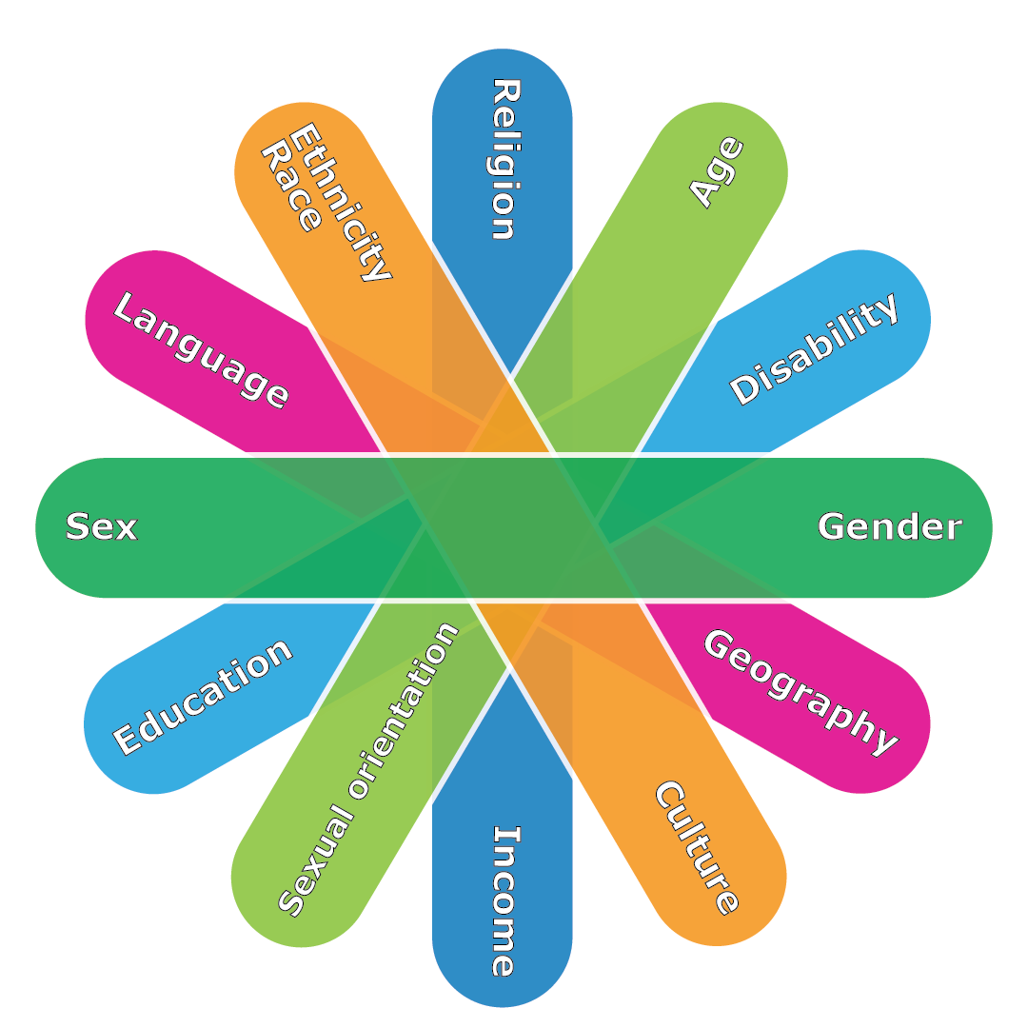
Strategies and Tips to Identify and Manage Unconscious Bias – 6
6
Adopt an inclusive mindset and lens in each step of the process when developing, renewing, or updating policies and directives, or when managing projects.

Slide 15

Strategies and Tips to Identify and Manage Unconscious Bias – 7
7
Empower yourself and others to engage in inclusive interactions and thinking.
Encourage inclusive interactions on a daily basis, such as during meetings or in decision-making processes.

Slide 16

Strategies and Tips to Identify and Manage Unconscious Bias – 8
8
Continue and enjoy the learning process!
Keep reflecting, be curious, practice, repeat and keep learning!

Slide 17

Break
Let’s take a quick break.
Please return in 10 minutes.
Please post a green checkmark (✓) when you are back from your break. Thank you!

Slide 18
Break
Please return in 9 minutes.
Please post a green checkmark (✓) when you are back from your break. Thank you!

Slide 19
Break
Please return in 8 minutes.
Please post a green checkmark (✓) when you are back from your break. Thank you!

Slide 20
Break
Please return in 7 minutes.
Please post a green checkmark (✓) when you are back from your break. Thank you!

Slide 21
Break
Please return in 6 minutes.
Please post a green checkmark (✓) when you are back from your break. Thank you!

Slide 22
Break
Please return in 5 minutes.
Please post a green checkmark (✓) when you are back from your break. Thank you!

Slide 23
Break
Please return in 4 minutes.
Please post a green checkmark (✓) when you are back from your break. Thank you!

Slide 24
Break
Please return in 3 minutes.
Please post a green checkmark (✓) when you are back from your break. Thank you!

Slide 25
Break
Please return in 2 minutes.
Please post a green checkmark (✓) when you are back from your break. Thank you!

Slide 26
Break
Please return in 1 minute.
Please post a green checkmark (✓) when you are back from your break. Thank you!

Slide 27
Three Important Skills
Humility
Be open to improving and learning about yourself and others.
Empathy
Listen actively to try to understand others and their own context, free of judgment, stereotypes and assumptions.
Cultural Intelligence
Be able to relate to others of different backgrounds, ethnicities, religious or spiritual beliefs, generations, abilities and disabilities, genders, sexual orientations and socio-economic backgrounds.

Slide 28

Activity – Facing Biases
Identify a situation where you think you were the subject of someone else’s unconscious bias.
Explain how this unconscious bias affected you, and how it may have also affected others around you.
Breakout Rooms

Slide 29
Questions

Slide 30
What To Prepare For Next Session
Facing Your Own Biases
Personal Learning Journal

